Slide 2
Welcome! Thank you for being part of our WAGGIN Chat Team
Local Chat
Kathy Douglas, Bowlby
Patty Hartenbach, Peters Twp
Michelle Jones, Uniontown
Mary Kipling, Peters Twp
Sydney Krawiec, Peters Twp
Donna Lehman, Bowlby
Stephanie Shultz, Peters Twp
Susan Strnisha, Citizens
Bill Zirkle, Carnegie Free
Local & PA Public Chat
Eileen Beveridge, Carnegie Free
Linda Esposito, Peters Twp
Christy Fusco, Uniontown
Laura Swanson, Chartiers-Houston
Jessica McClelland, Citizens
Jessica Miller, WCLS
Sue Miller, Peters Twp
Shannon Pauley, Peters Twp
Melinda Tanner, District Services
Chat Administrators
Ed Wolf, Peters Twp (Administrator)
Stefanie Maclin-Hurd, District Services, (Co-Administrator)

Slide 3
What is Chat with a Librarian?
Chat with a Librarian is an online reference service, provided by the Office of Commonwealth Libraries, Bureau of Library Development
Chat is available 24/7 and is staffed by librarians and support staff from public and academic libraries across the state
It is managed by HSLC (Hosting Solutions and Library Consulting), who also administers PA POWER Library
The Chat Support Specialist at HSLC is Tracy Carey, MLS

Slide 4
What is Chat with a Librarian?
The software used for Chat is LibAnswers, created by Springshare
LibAnswers offers the ability for both Online Reference and Offline E-mail Reference
Local chat staff can can work either WAGGIN Chat with a Librarian local service or the state-wide PA Public Chat service
Our administrator for Chat with a Librarian is Ed Wolf (Peters Township Public Library)
Ed and Stefanie Maclin-Hurd (District Services) will coordinate WAGGIN Chat with a Librarian

Slide 5
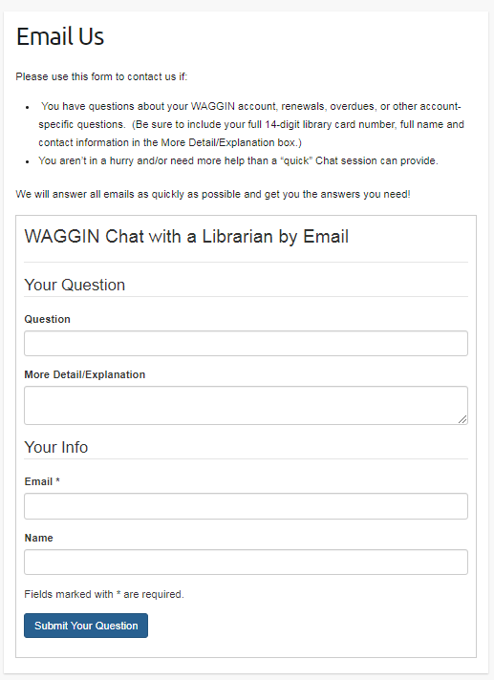
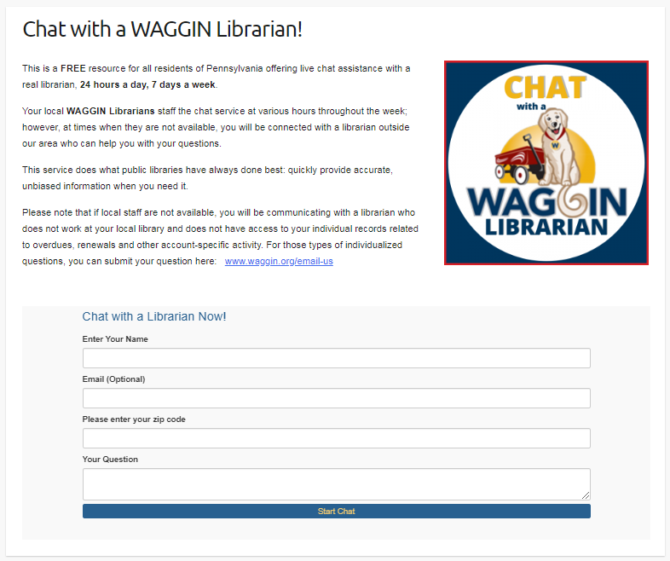
WAGGIN Chat with a Librarian
Patrons can access this new service in two ways:
WAGGIN Chat with a Librarian /
PA Public Chat with a Librarian
Live Chat
WAGGIN Chat with a Librarian
Email Reference
www.waggin.org/chat-with-a-librarian
www.waggin.org/email-us/

Slide 6
Setting up your LibAnswers account:
Log into LibAnswers:
https://powerlibrary.libapps.com/
Username: (your email)
Password:
The link can be found on the back page of your Training Manual
If you forget your password, enter your email address and click “reset password”

Slide 7
Setting up your LibAnswers account:
Once you are logged in, click on your name in the upper right corner to access the “Manage Account” page

Slide 8
Setting up your LibAnswers account:
Create a “nickname” for your account
This is what the patrons will see when they are chatting with you, and can be anything you choose, but should serve to protect your actual identity in the online chat environment
Your real name will still be seen from the Dashboard and used for statistics, tickets, and transcripts

Slide 9
Your Dashboard :
The Dashboard is the “hello” screen you will see whenever you log into LibAnswers
You can see your current “chat” status, either online or offline, at the top of the page
You can also access any “tickets” that may have come in by scrolling down to the bottom of the page (more on that later)

Slide 10
Logging on to Chat:
You can see your current “chat” status, either online or offline, at the top of the page
You can sign in here by clicking the Sign In link OR
You can click the “LibChat” tab on the orange command bar and choose Connect

Slide 11
WAGGIN Chat versus PA Public Chat:
Some of you will be staffing the WAGGIN Chat with a Librarian service, while others will be staffing both WAGGIN Chat and PA Public Chat
WAGGIN Chat with a Librarian is the name for our local service, and is available primarily to patrons/residents of the WAGGIN Counties;
Patrons/residents can get to the WAGGIN Chat page by accessing the links on any of the WAGGIN libraries’ web pages
PA Public Chat with a Librarian are online “chats” coming from all across the state of Pennsylvania
Patrons/residents can get to the PA Public Chat page by accessing links on library websites, through library system pages, or through the PA POWER Library website

Slide 12
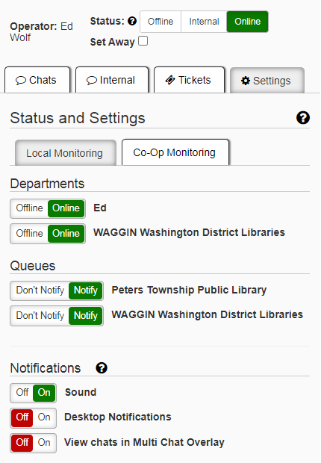
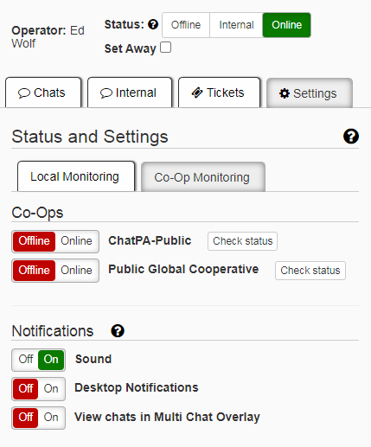
Logging on to Chat:
WAGGIN Chat
(Local Monitoring)
Logging on to Chat:
PA Public Chat
(Co-Op Monitoring)
To “turn” on/off a chat system, just click on the Offline/Online button to toggle it on/off
Remember to turn to toggle the Notification - Sound button, so that you will be notified when a new chat comes in!

Slide 13
Claiming a Chat
When a new chat comes in, you will be notified several ways:
A new chat will appear in the Chats tab
A notification chime will sound (if you have sound notifications on)

Slide 14
Claiming a Chat
To examine the chat before picking it up, from the Chats tab click on the patron’s name
Their question will appear on the right-side of the screen
Other information will appear on the left-side of the screen, including what Site they began their chat from and what Group Member Library they are coming from

Slide 15
Claiming a Chat
To claim the chat, click blue Claim Chat button located to the right of the patron’s name in the Chat tab
The actual chat will display in the right-hand window

Slide 16
Chatting
Enter your responses in the text box at the bottom of the right-side window

Slide 17
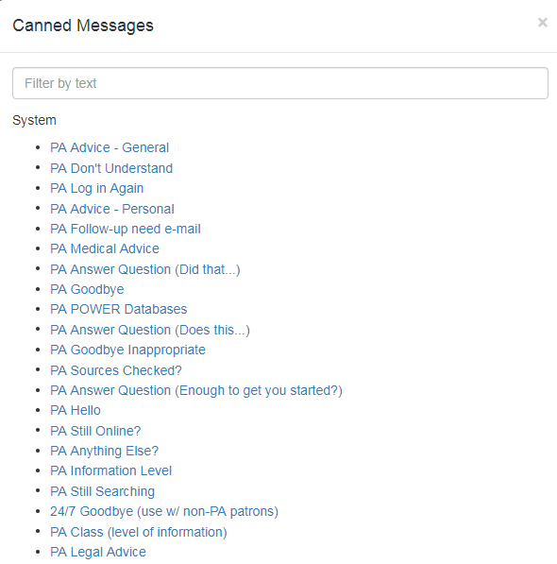
Chatting
To help you, there are many “canned” responses already saved in LibAnswers for you to use
These can help save you time when responding OR buy you time while you are looking for a response

Slide 18
Chatting
Perform your Reference Interview and begin helping the patron
Things to remember:
Genuine questions deserve genuine answers--don’t automatically refer a patron back to their home library IF a potential solution can be found
Sometimes you have to tweak out the real question, particularly if a patron’s opening statement is “hey” or “do you play minecraft?”
Some questions can be quickly answered--typically these are referred to as “ready reference”, and the answers can be found easily on the internet
Other questions may require you to lead a patron to a source or provide the patron with a search query--the purpose of chat isn’t always to give an exact answer

Slide 19
Chatting
Should you need it, each system who participates in Chat with a Librarian has their own unique FAQ, which covers library-specific information such as hours, printing, room rentals, and more
To access an FAQ, click on the FAQ tab at the top of the chat window
Note: FAQs for patrons accessing Chat from the POWER Library page will be general, and not specific to their actual home library

Slide 20
Chatting
When your chat is finished, determine if there is a need to a follow-up “ticket” to be created
This can be done if the patron’s question can only be answered by their home library or if the question requires additional time/effect
To create a ticket, click on the ticket icon at the top of the chat window

Slide 21
Chatting
Once you’ve created a ticket OR if the chat is finished and doesn’t require a ticket, click the End Chat button at the top-right of the chat window
To remove the chat from the screen, click the Close Chat button

Slide 22
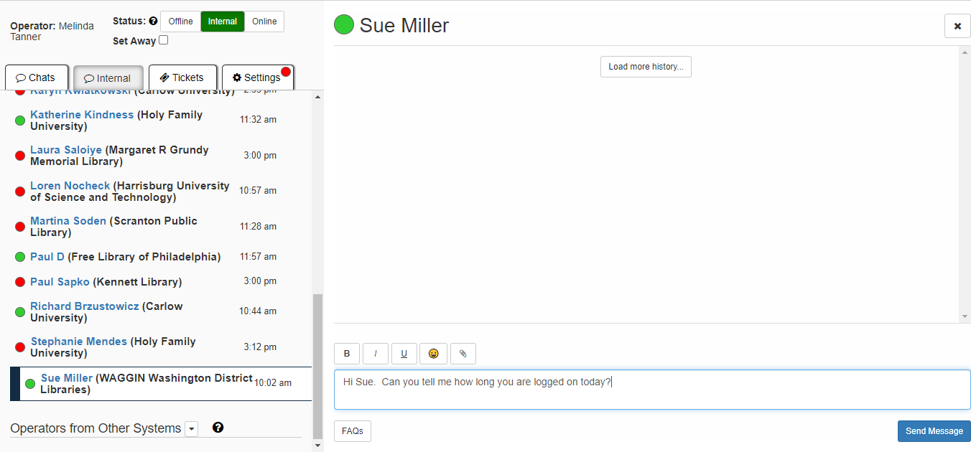
Internal Chats
If you would like to communicate with another person monitoring chat (to say hello or ask a question), click the “Internal Chat” tab
Green circles indicate online; red circles indicate offline
Click on a person’s name and a chat window will appear on the right

Slide 23
Tickets
Tickets refer to both chats that have been marked for follow-up by a WAGGIN library AND chat requests submitted offline, via email
You can access open tickets either from the LibAnswer’s Dashboard (bottom of the page) OR the Tickets tab on the Chat screen
OR

Slide 24
Tickets
Anyone staffing the the WAGGIN Chat with a Librarian service can (and should) answer open tickets
Tickets should always be answered IN LibAnswers (at least for the initial contact)…
Even though the patron has provided their email address
And even though it would just be much easier to answer from your work email
We only get statistics from interactions that occur within LibAnswers
Chat staff can provide their work email addresses in their LibAnswers response IF they choose; they can also provide work email addresses for other staff members if needed

Slide 25
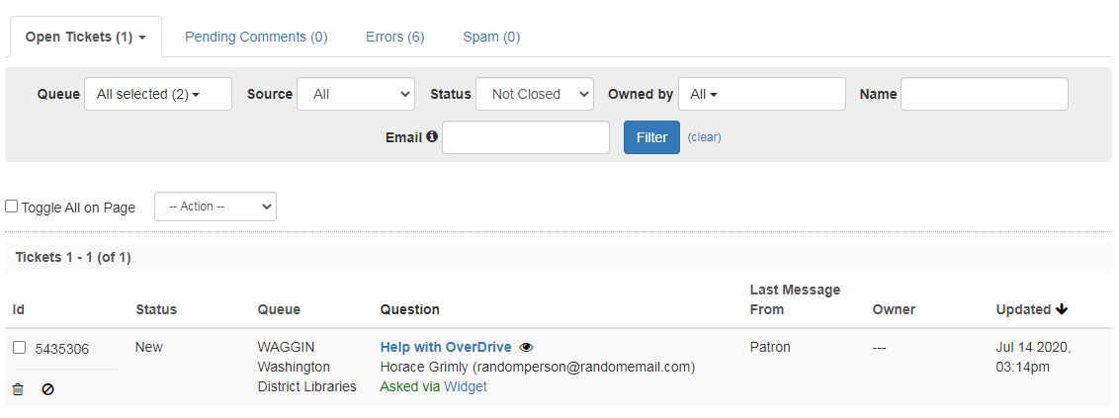
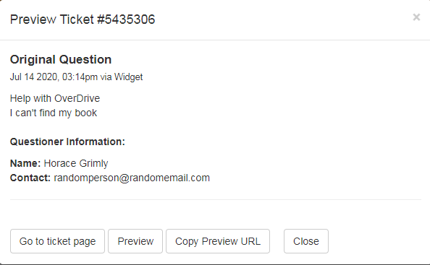
Tickets
To preview the ticket, click the EYE icon next to the patron’s question
To claim a ticket, just click on the question
If you accidentally claimed a ticket, click on the Unclaim button, located on the ticket screen, to the right of your name

Slide 26
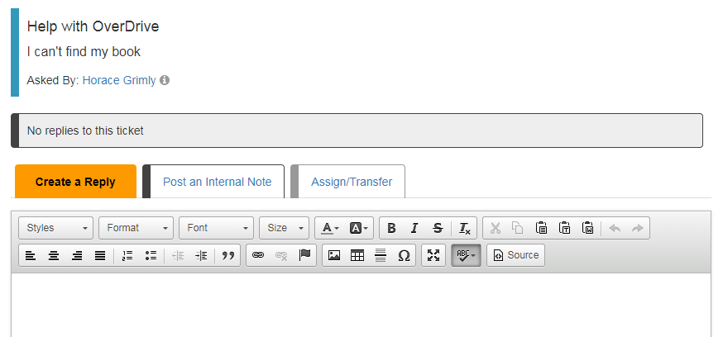
Tickets
Enter your response in the Reply Box; if needed, you can also attach files and/or Carbon Copy (CC) someone into the reply
To submit your response, scroll to the bottom of the ticket window and select an option from the blue Submit button drop-down menu
Submit as Closed will send the response and remove the tickets completely from the queue—so this should only be done IF the interaction is completed
Submit and Leave Open will allow the Chat staff to answer a question but leave the ticket open and visible should further interaction be needed

Slide 27
Best Practices
Excellent Customer Service
Virtual Reference Basics: See page 5 of the Training Manual
POWER Resources
Free Online Resources
Canned answers
Study the Scenarios

Slide 28
RUSA Standards applied to Chat/Virtual Reference Interactions
(Reference & User Services Association, a Division of ALA)
https://journals.ala.org/index.php/rusq/article/view/3993/4505
Be ready
Don’t keep the patron waiting
Welcome Message
Show interest: “word contact” vs. “eye contact”
Listen: let them ask their question fully
Inquire: ask open-ended questions to make sure you have identified their needs
Rephrase the question
Avoid using jargon
Be receptive, cordial & encouraging
Find out what search strategies they may have already tried
Keep the chat moving: explain your research, terms you may be using, offer search tips…
Make sure the patron is satisfied with the search results
Do they have any further questions
Thank them!

Slide 29
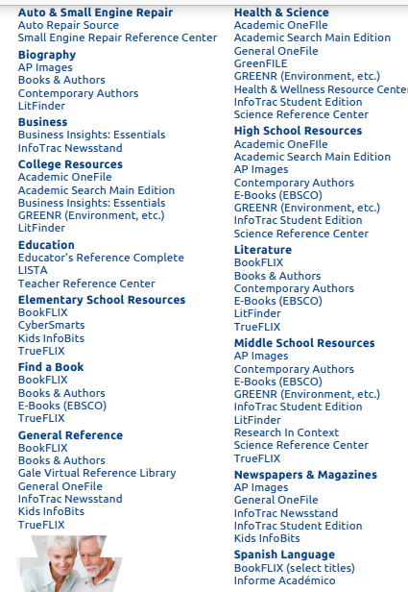
POWER Library Resources by Topic
https://document.powerlibrary.org/files/portal/pdf/promotional-materials/EresourcesTrifold_SelfPrint.pdf

Slide 30
Free Online Resources:
http://waggin.org/pa-quick-links/
https://quarryvillelibrary.org/resources/free-web-resources/
https://www.libraryjournal.com/?detailStory=best-free-reference-sources
https://www.coloradovirtuallibrary.org/technology/online-reference-resources/
http://www.nysl.nysed.gov/reference/readyref.htm
Encyclopedia Britannica: Google “topic+Britannica”

Slide 31
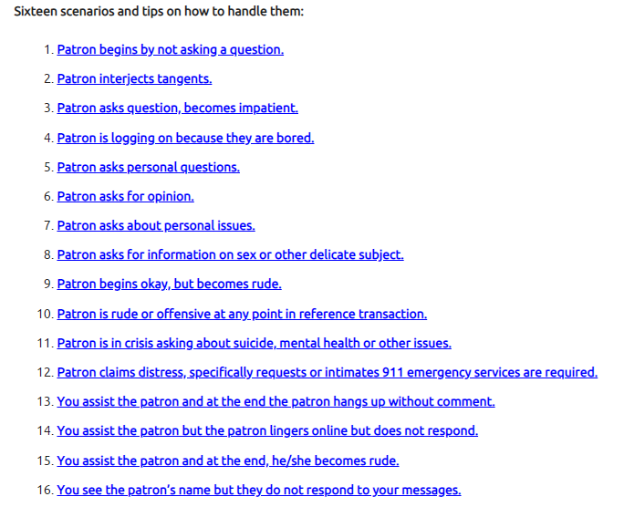
Chat scenario guidelines (for when things go “south”):
https://powerlibrary.org/librarians/live-chat-reference/staff-use/general-guidelines-for-chat-scenarios/#.XvZIVBOSnIU

Slide 32
Resources
Chat with a Librarian Staff Use Web Page:
https://powerlibrary.org/librarians/live-chat-reference/staff-use/
Training: https://training.springshare.com/CTE/CHATPA-STAFF
Don’t forget your Training Manual!
Call or email one of us.

Slide 33
How to reach us:
Ed Wolf, Chat Administrator: EWolf@pt-library.org
Stefanie, Co-Coordinator: smaclin-hurd@citlib.org
Melinda Tanner, District Services Manager: mtanner@citlib.org

